Slide 1
CS 3006 Parallel and Distributed Computing Lecture 14
Danyal Farhat
FAST School of Computing
NUCES Lahore

Slide 2
Basic Communication Operations – Part 2

Slide 3
Outline
Basic Communication Operations
All-Reduce
Prefix Sum
Scatter and Gather
All-to-All Personalized
All-to-All Personalized [Ring] Cost Analysis
All-to-All Personalized [Mesh] Cost Analysis
Exercise
Summary
Additional Resources

Slide 4
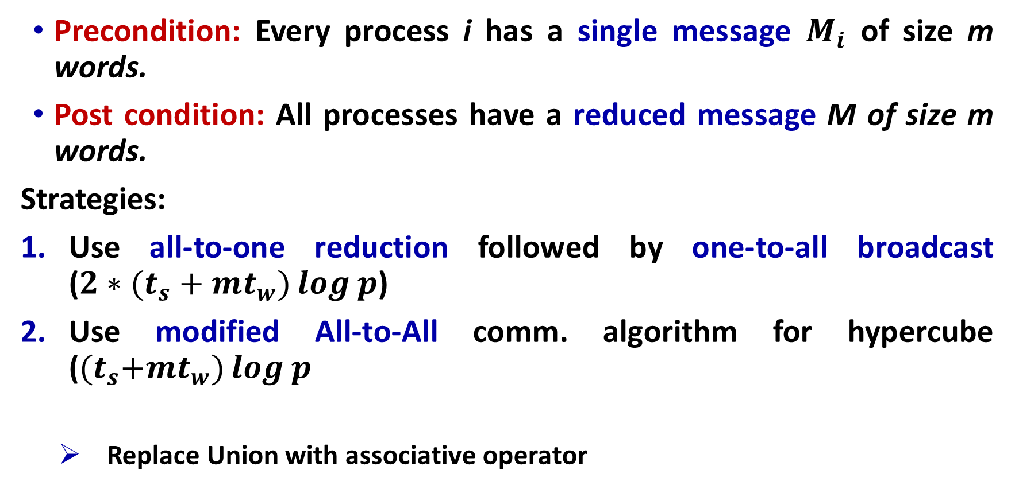
All-Reduce
Precondition: Every process i has a single message $M_{i}$ of size m words.
Post condition: All processes have a reduced message M of size m words.
Strategies:
Use all-to-one reduction followed by one-to-all broadcast (${2∗(t}_{s}+mt_{w})\log{p}$)
Use modified All-to-All comm. algorithm for hypercube (${(t}_{s}+mt_{w})\log{p}$
Replace Union with associative operator

Slide 5
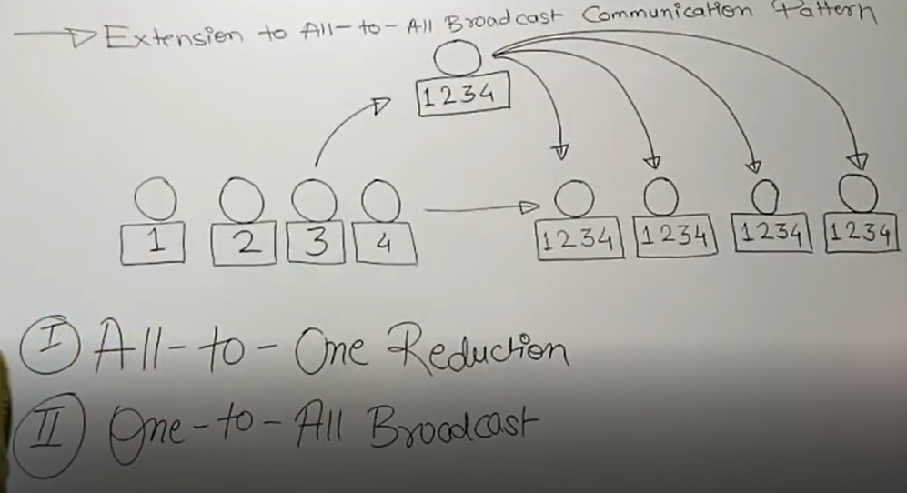
All-Reduce (Cont.)

Slide 6
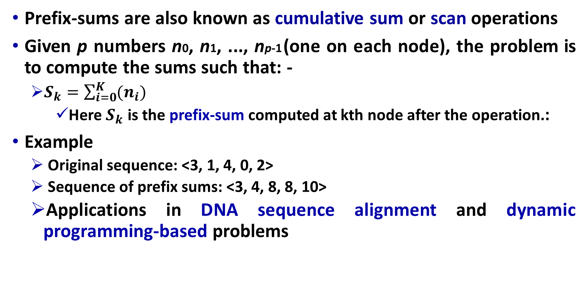
Prefix Sum
Prefix-sums are also known as cumulative sum or scan operations
Given p numbers n0, n1, ..., np-1 (one on each node), the problem is to compute the sums such that: -
$S_{k}=\sum_{i=0}^{K}{(n_{i})}$
Here $S_{k}$ is the prefix-sum computed at kth node after the operation.:
Example
Original sequence: <3, 1, 4, 0, 2>
Sequence of prefix sums: <3, 4, 8, 8, 10>
Applications in DNA sequence alignment and dynamic programming-based problems

Slide 7
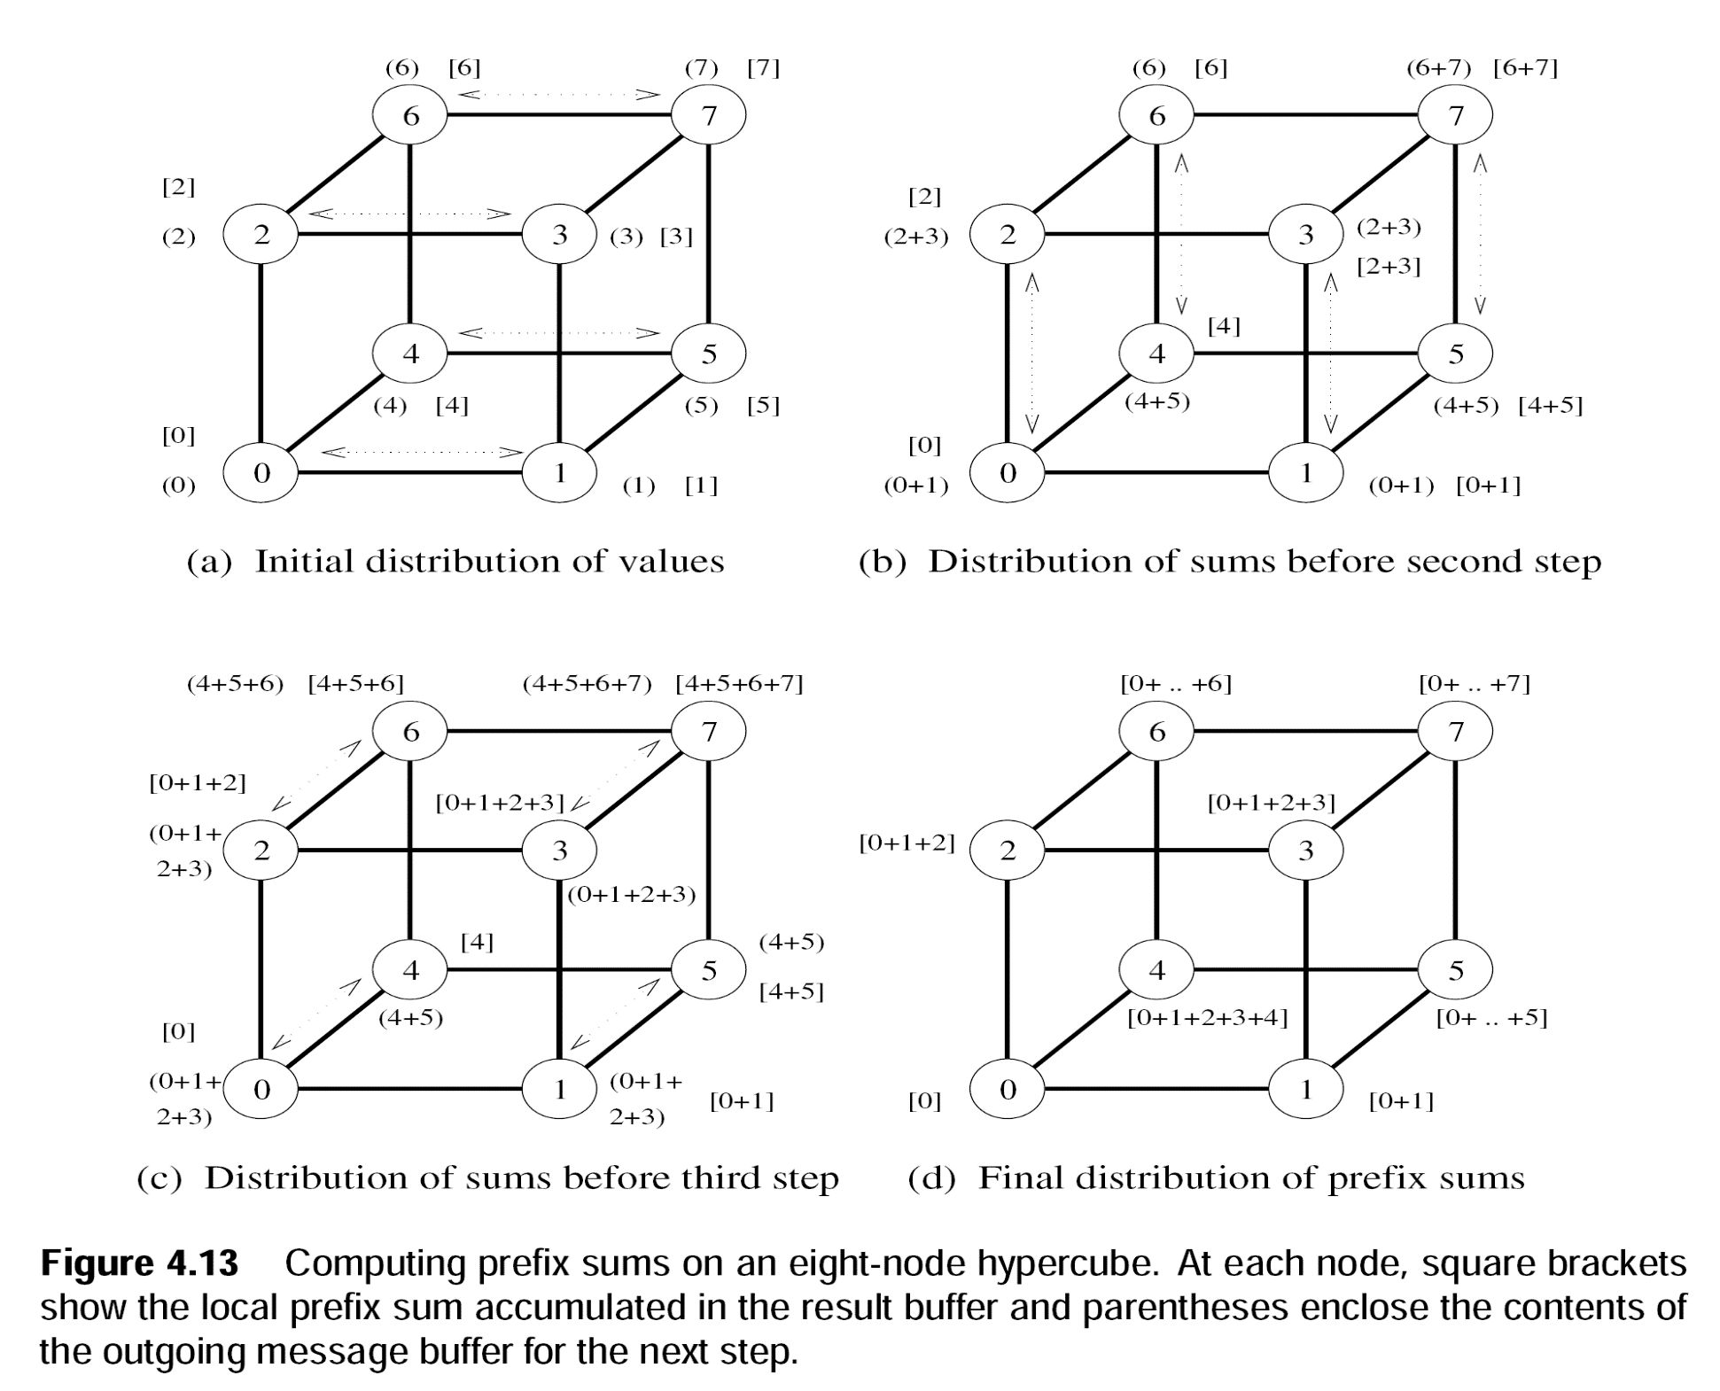
Prefix Sum (Cont.)
Notes:
Round Bracket: That message is sent to other node in next step
Square Bracket: That message is kept with the node
Lower index node will keep message in square bracket as it is.
Higher index node will add message in square bracket that it got from lower index node.
Communication cost is same as one-to-all broadcast

Slide 8
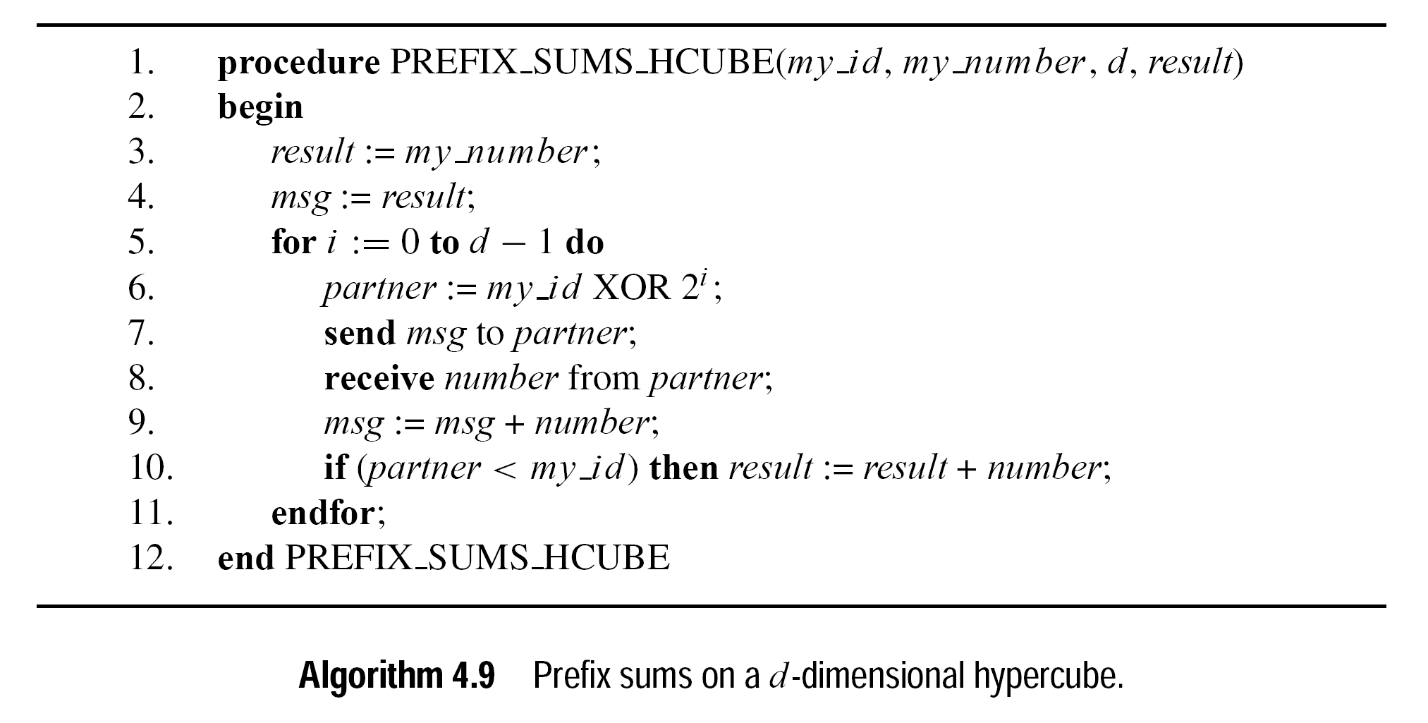
Prefix Sum (Cont.)
Notes:
MY_NUMBER: my initial value; msg serves as a buffer with parathesis ( )
Result buffer: serve as a buffer shown by square brackets in the figure [ ]

Slide 9
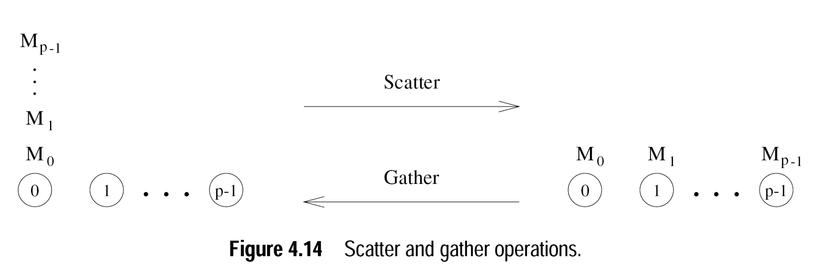
Scatter and Gather
Gather is different than reduction as it doesn’t reduce the results with associative operator

Slide 10
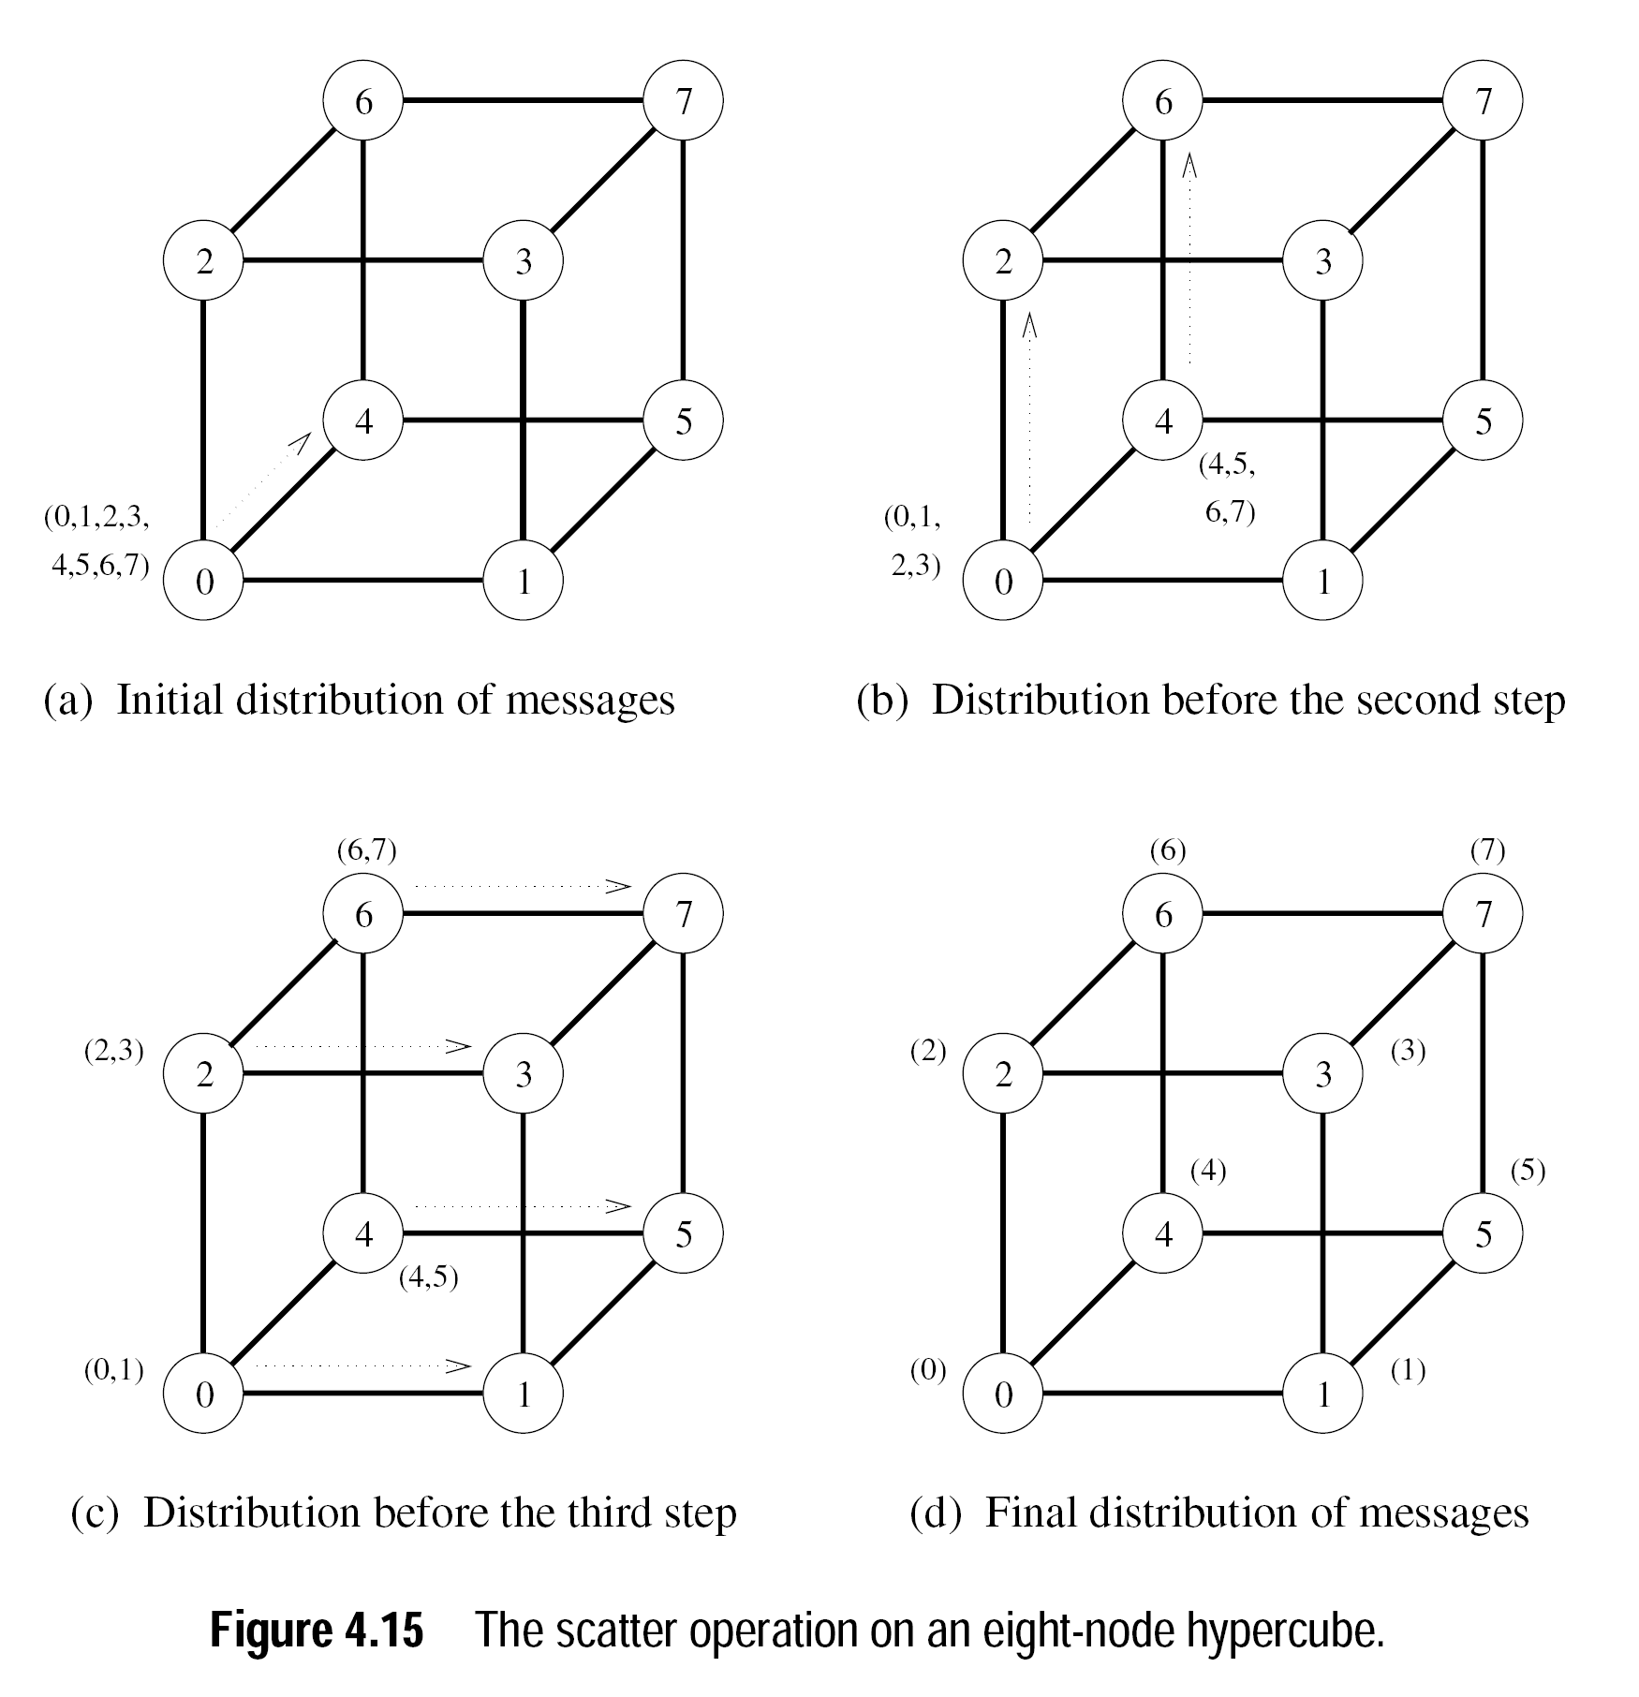
Scatter and Gather (Cont.)
Notes:
Cost is same as All-to-All broadcast: Total Cost= $\sum_{i=1}^{log(p)}{{(t}_{s}+2^{i−1}mt_{w})}$
Answer ${T=(t}_{s}\log{p}+mt_{w}(p−1))$

Slide 11
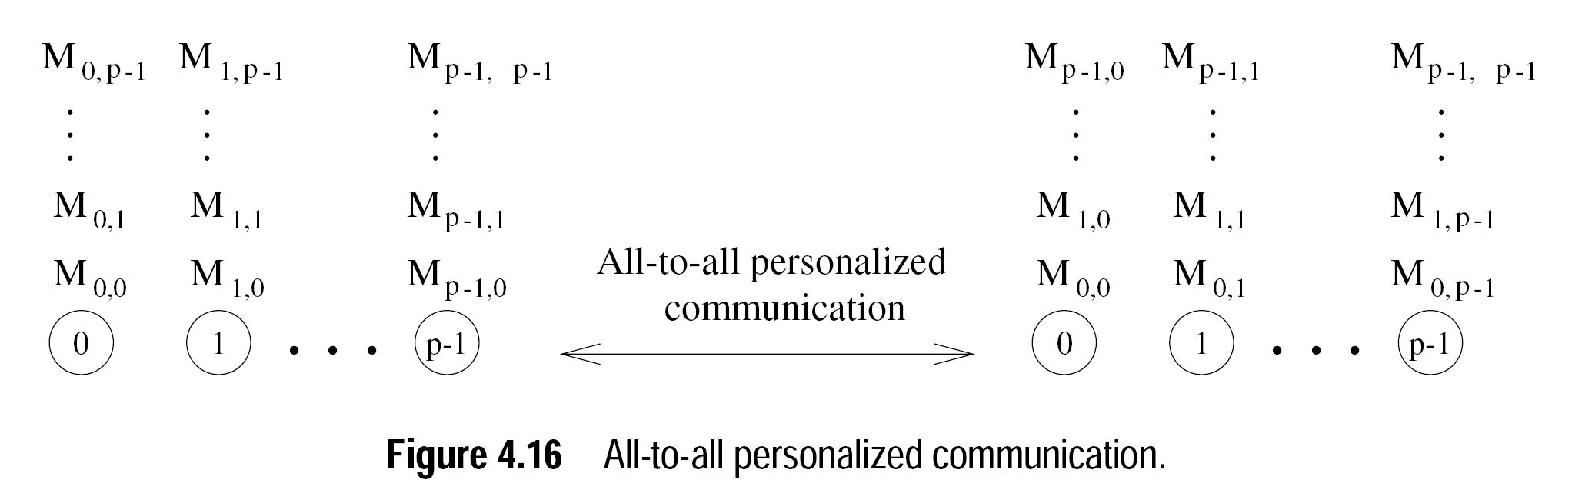
All-to-All Personalized
Each node sends a distinct message of size m to every other node
Also known as total exchange
Usually used for distributed matrix transpositions, Fourier transformations, Sample sort [last step] and uTorrent

Slide 12
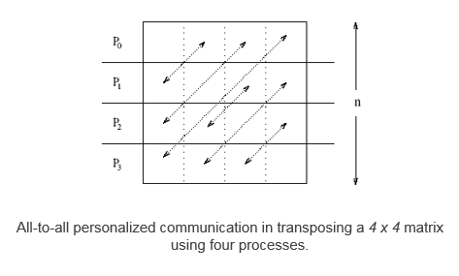
All-to-All Personalized (Cont.)

Slide 13
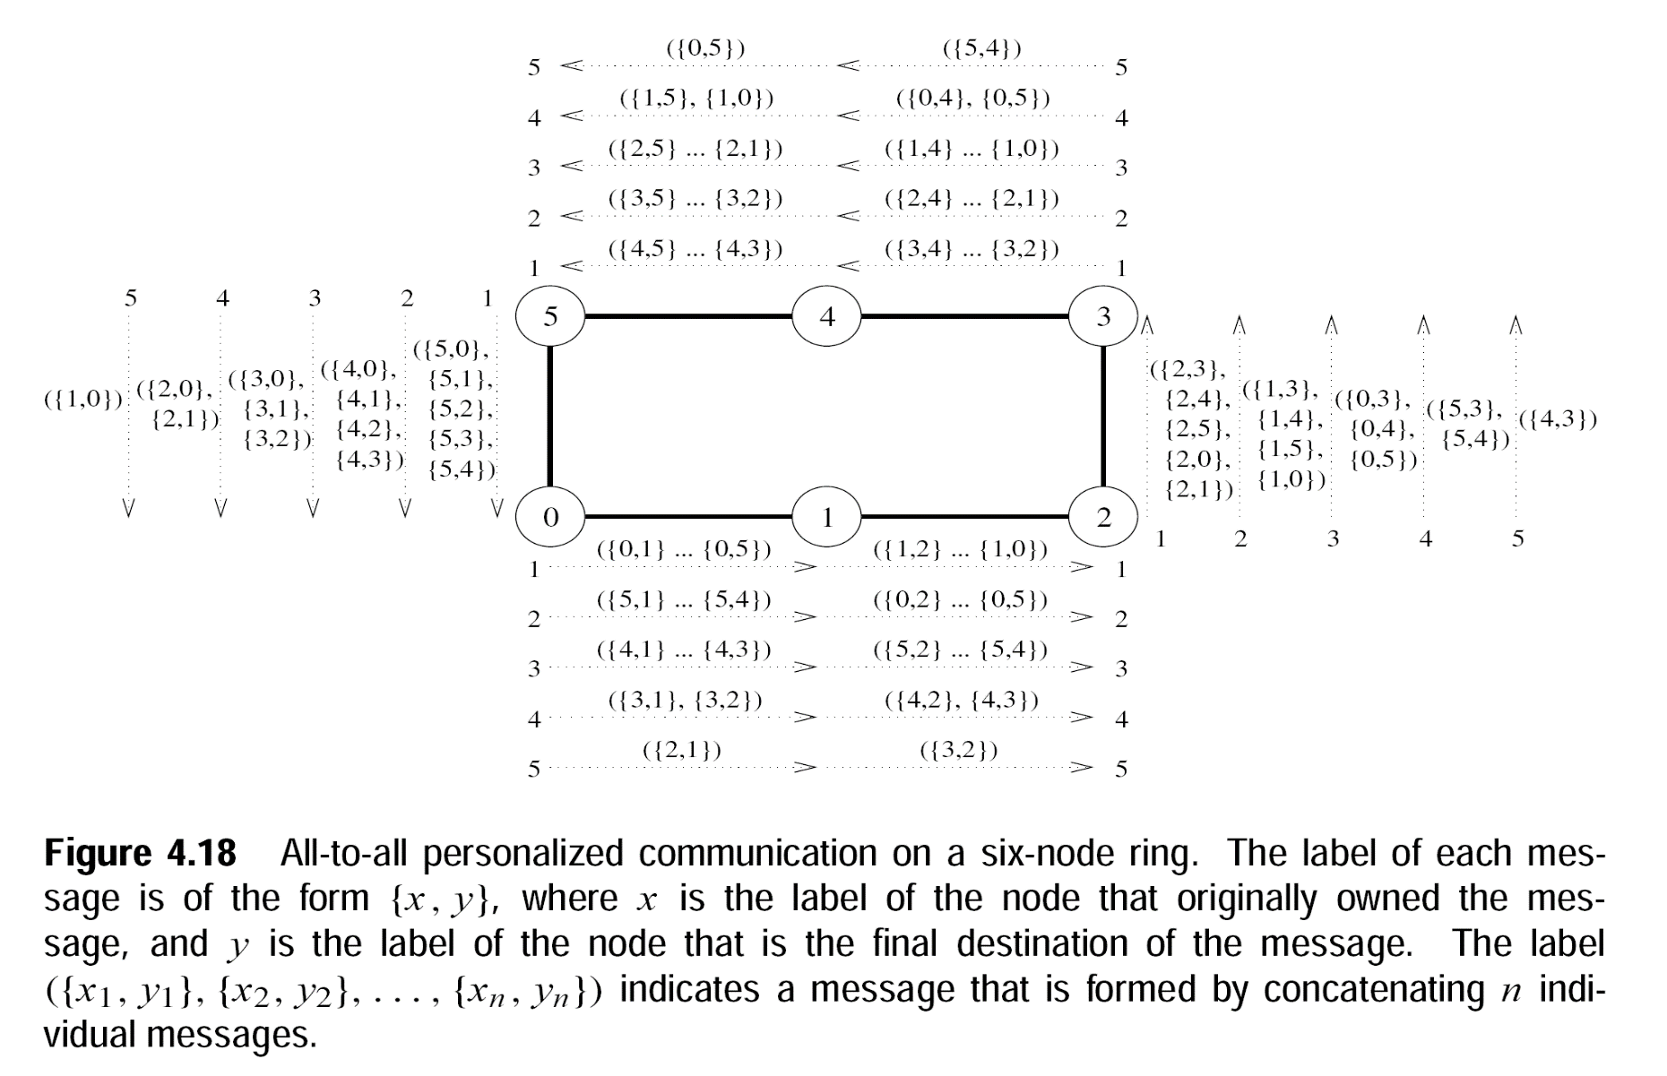
All-to-All Personalized (Cont.)

Slide 14

All-to-All Personalized [Ring]
Cost Analysis
$T=\sum_{i=1}^{(p−1)}{{(t}_{s}+(p−i)mt_{w})}$
=$\sum_{i=1}^{(p−1)}{{(t}_{s})+ mt_{w}\sum_{i=1}^{(p−1)}{(p−i) })}$
→ $\left(p−1\right){(t}_{s}) + mt_{w}\sum_{i=1}^{(p−1)}{(i) }$
→ $\left({(t}_{s}+\left(\frac{1}{2}\right)pmt_{w}\right)\left(p−1\right)$

Slide 15
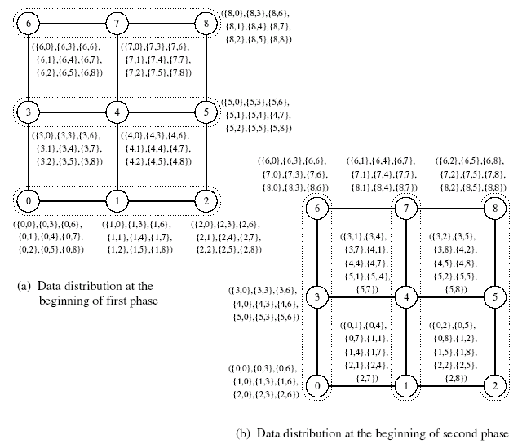
All-to-All Personalized [Mesh]

Slide 16
All-to-All personalized [Mesh]
Cost Analysis
Time for the first phase is identical to that in a ring with √p processors, i.e., (t_{s} + t_{w}mp/2)(√p – 1).
Here mt_{w} becomes √p mt_{w} and P becomes √p
Time in the second phase is identical to the first phase. Therefore, total time is twice of this time, i.e.,
2 [(t_{s} + t_{w}mp/2)(√p – 1)].

Slide 17
Exercise
Dry run all reduce operation on 8 nodes.

Slide 18
Summary
Basic Communication Operations
All-Reduce
Use all-to-one reduction followed by one-to-all broadcast
Prefix Sum
Also known as cumulative sum or scan operations
Applications in DNA sequence alignment and dynamic programming-based problems
Scatter and Gather
Gather is different than reduction, doesn’t reduce the results with associative operator

Slide 19
Summary (Cont.)
Basic Communication Operations
All-to-All Personalized
Each node sends a distinct message of size m to every other node
All-to-All Personalized [Ring] Cost Analysis
All-to-All Personalized [Mesh] Cost Analysis
Exercise

Slide 20
Additional Resources
Introduction to Parallel Computing by Ananth Grama and Anshul Gupta
Chapter 4: Basic Communication Operations

Slide 21
Questions?

